Slide 1
Module II Supervised and Unsupervised Learning
Linear Regression

Slide 2
Linear Regression
Linear Regression is a supervised learning algorithm that is used to model the relationship between a dependent variable and an independent variable.
The algorithm finds the best fit straightline relationship (linear equation) between the two variables.
This statistical method is then used to predict the outcome of future events and is quite useful for predictive analysis.
Ex:determine the salary of a person based on the number of years of work experience they have.

Slide 3
Linear Regression Importance
starting point for machine learning
helps in predictive analysis
computationally efficient making

Slide 4
Real-World Applications of Linear Regression
In real estate, the algorithm can help you predict house prices based on the size of the house, number of bedrooms, location, and access to other facilities.
In marketing, linear regression used to predict the sales volume based on seasonal shifts, past purchasing trends advertising costs, etc.

Slide 5
Linear Regression
Linear regression makes predictions for continuous/real or numeric variables such as sales, salary, age, product price, etc.
Linear regression algorithm shows a linear relationship between a dependent (y) and one or more independent (y) variables, hence called as linear regression.
The linear regression shows the linear relationship, which means it finds how the value of the dependent variable is changing according to the value of the independent variable.
The linear regression model provides a sloped straight line representing the relationship between the variables.

Slide 6
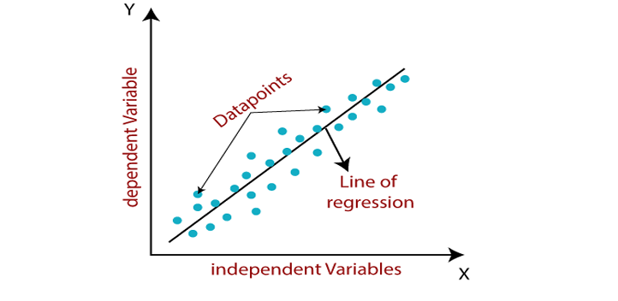
Contd.,
The graph below presents the linear relationship between the output(y) and predictor(X) variables

Slide 7
A linear regression as: y= a0+a1x+ ε
Here, Y= Dependent Variable (Target Variable)
X= Independent Variable (predictor Variable)
a0= intercept of the line (Gives an additional degree of freedom)
a1 = Linear regression coefficient (scale factor to each input value).
ε = random error The values for x and y variables are training datasets for Linear Regression model representation.

Slide 8
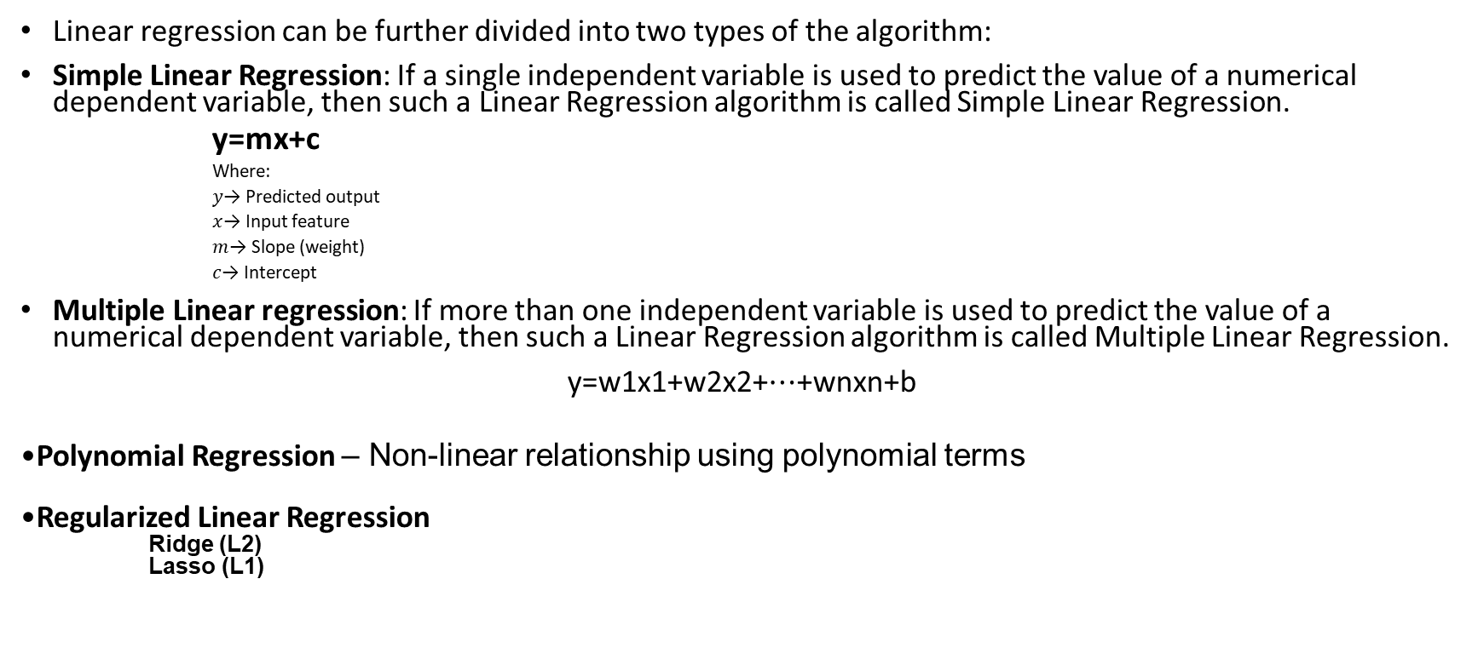
Types of Linear Regression

Slide 9
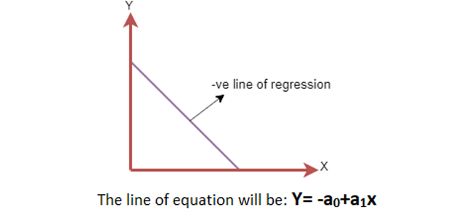
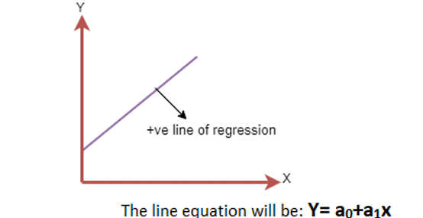
Objective of Linear Regression
To find the best-fit line that minimizes the difference between actual and predicted values.
Linear Regression Line A linear line showing the relationship between the dependent and independent variables is called a regression line. Positive Linear RelationshipNegative Linear Relationship
This is achieved by minimizing the cost function.

Slide 10
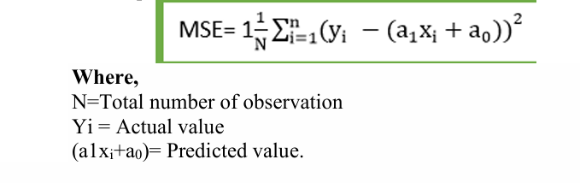
Cost function-
Cost function optimizes the regression coefficients or weights. It measures how a linear regression model is performing.
The most commonly used cost function is Mean Squared Error (MSE):
Penalizes large errors more
Forms a convex curve → single global minimum

Slide 11
Gradient Descent
Gradient Descent is an optimization technique used to minimize the Mean Squared Error (MSE) of a regression model.
It works by computing the gradient (slope) of the cost function.
The regression model updates the line parameters (slope and intercept) in the direction that reduces the error.
The algorithm starts with randomly chosen coefficient values and repeatedly updates them.
This iterative process continues until the minimum error (lowest cost) is reached.
Example
In house price prediction, gradient descent gradually adjusts the regression line so that the difference between predicted and actual house prices becomes minimum.

Slide 12
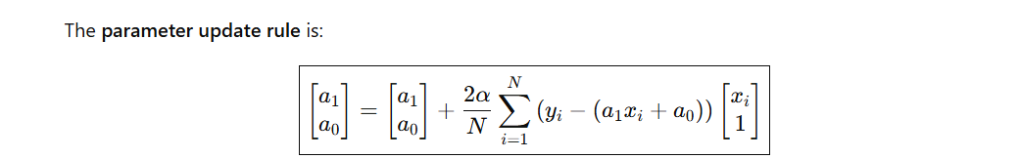
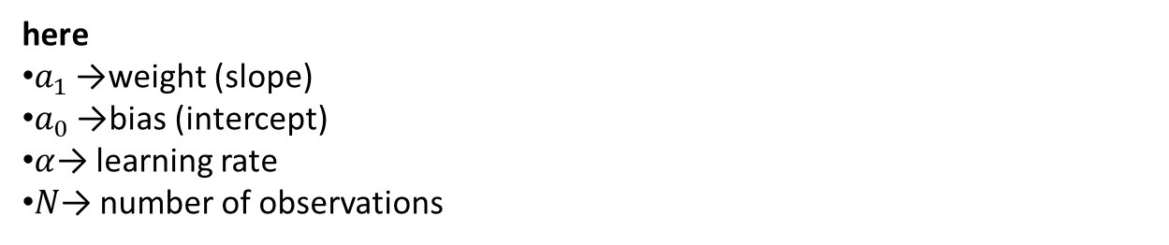
Gradient Descent

Slide 13
Model Performance
Model performance indicates how well the regression line fits the given data points.
A good model produces predictions that are very close to actual values.
Selecting the best model from several possible models is called optimization.

Slide 14

Optimization Using R-Squared Method R-Squared (R²) Method
R-squared is a statistical measure used to evaluate the goodness of fit of a regression model.
It indicates how strongly the independent variables influence the dependent variable.
The value of R² lies between 0 and 1 (or 0% to 100%).
A higher R² value means the model explains more variation in the output.
Interpretation
R² = 0.90 (90%) → The model explains 90% of the variation → Very good fit
R² = 0.30 (30%) → Poor explanation → Weak model

Slide 15
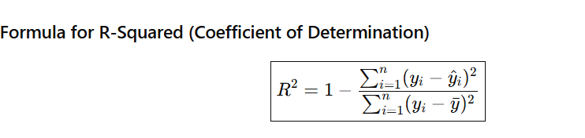
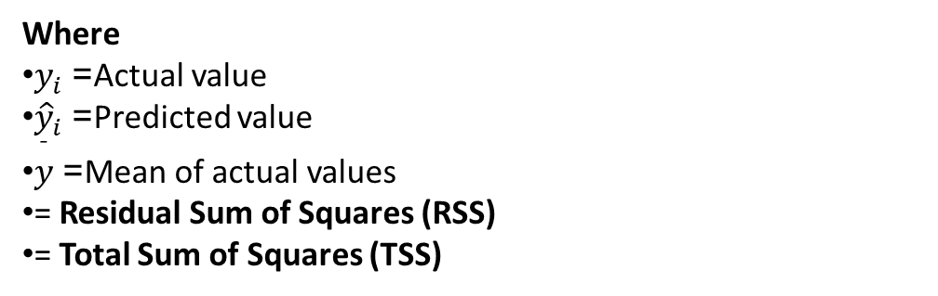
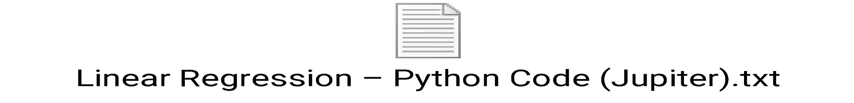
Sample code

